Slide 1
TITANIC

Slide 2
INTRODUCTION
Python: Python is a clear and powerful object-oriented programming language, co Ruby, Scheme or
Ruby, Scheme or Java.
Python Features:
• Comes with a large standard library that support many common programming task such as connecting to web servers, searching text with regular expressions, reading and modifying files.
• Runs anywhere, including Mac OS X, Windows, Linux and Unix with unofficial builds also available for Android and iOS.
• Uses an elegant syntax, making the programs we write easier to read.
Python’s Programming Language Features:
• Python support object-oriented programming with classes and multiple inheritance
• Data types are strongly and dynamically typed. Mixed incompatible type (e.g. Attempting to add a string and a number) causes an exception to be raised, so errors are caught sooner.

Slide 3
INTRODUCTION TO MACHINE LEARNINIG
Machine learning is an application of artificial intelligence (AI) that provides system the ability to automatically learn and improve from experience without being explicitly programmed. Machine learning focuses on the development of computer programs that can access data and use it learn for themselves
The primary aim is to allow the computers learn automatically without human intervention or assistance and adjust actions accordingly.
Applications:
• Handwriting Recognition
• Medical Diagnosis
• Email Spam Filtering
• Recommendation Engine
• Face Detection
• Fraud Detection

Slide 4
INTRODUCTION TO NumPy AND Pandas
NumPy:
• NumPy (Numeric Python) is a linear algebra library for python.
• NumPy enriches the programming language Python with powerful data structure for efficient computation of multi-dimensional arrays and matrices.
• The number of dimensions is the rank of the array; the shape of an array is a tuple of integers giving the size of the array along each dimension.
Pandas:
• Pandas is the most popular python library that is used for data analysis.
• It provides highly optimized performance with back-end source code is purely written in C or Python.
• We analysis data in pandas with:
❖ Series (1-d array)
❖ Data Frame (2-d array)

Slide 5
Titanic survival prediction
“titanic survuval prediction” problem we are asked to predict whether a passenger travelling
survived or not during the tragedy .
Aim: Our aim was to try to find and analyze which person survived the and to show the
different grapshs of the tragedy .

Slide 6
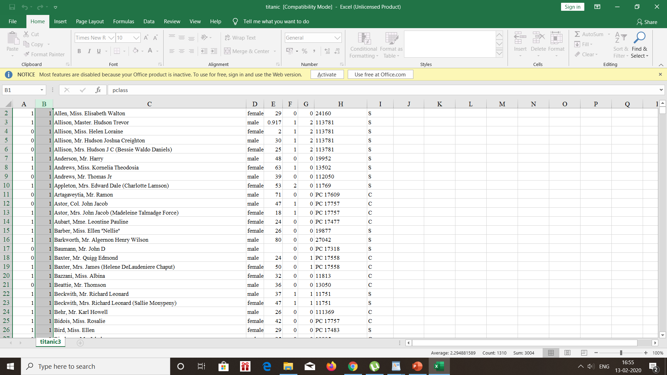
Display titanic excel file

Slide 7
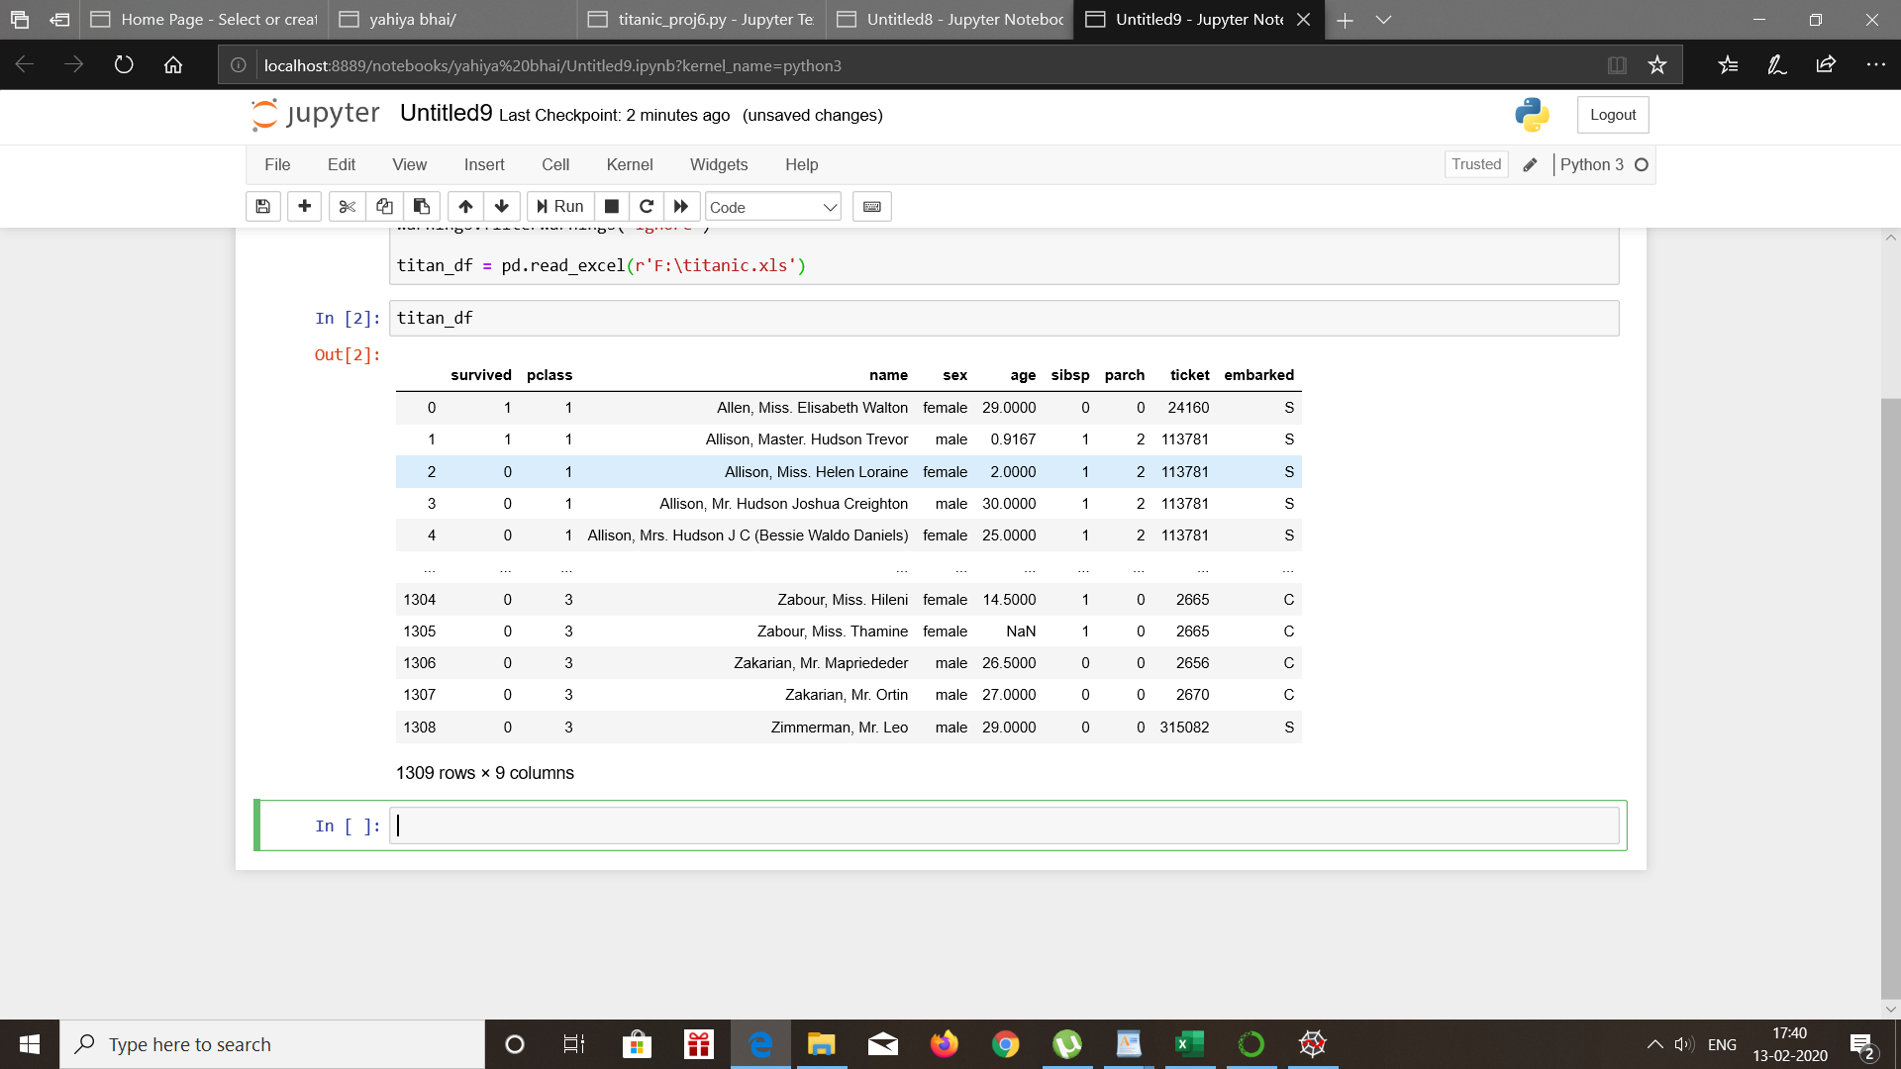
Convert Titanic excel on Pandas DF

Slide 8
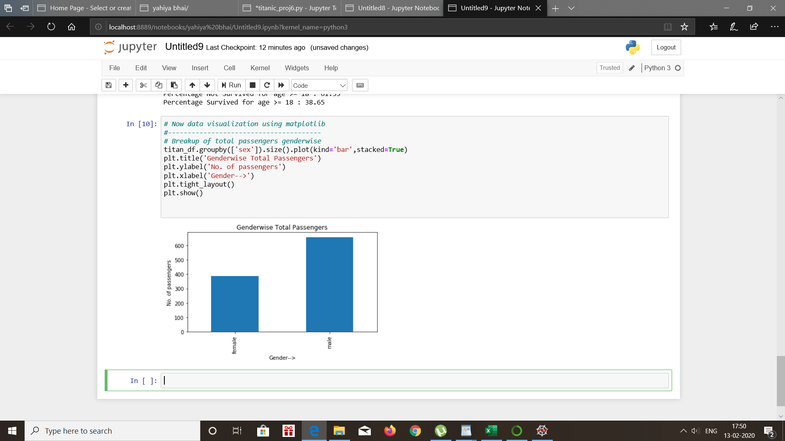
Gender Wise total passengers

Slide 9
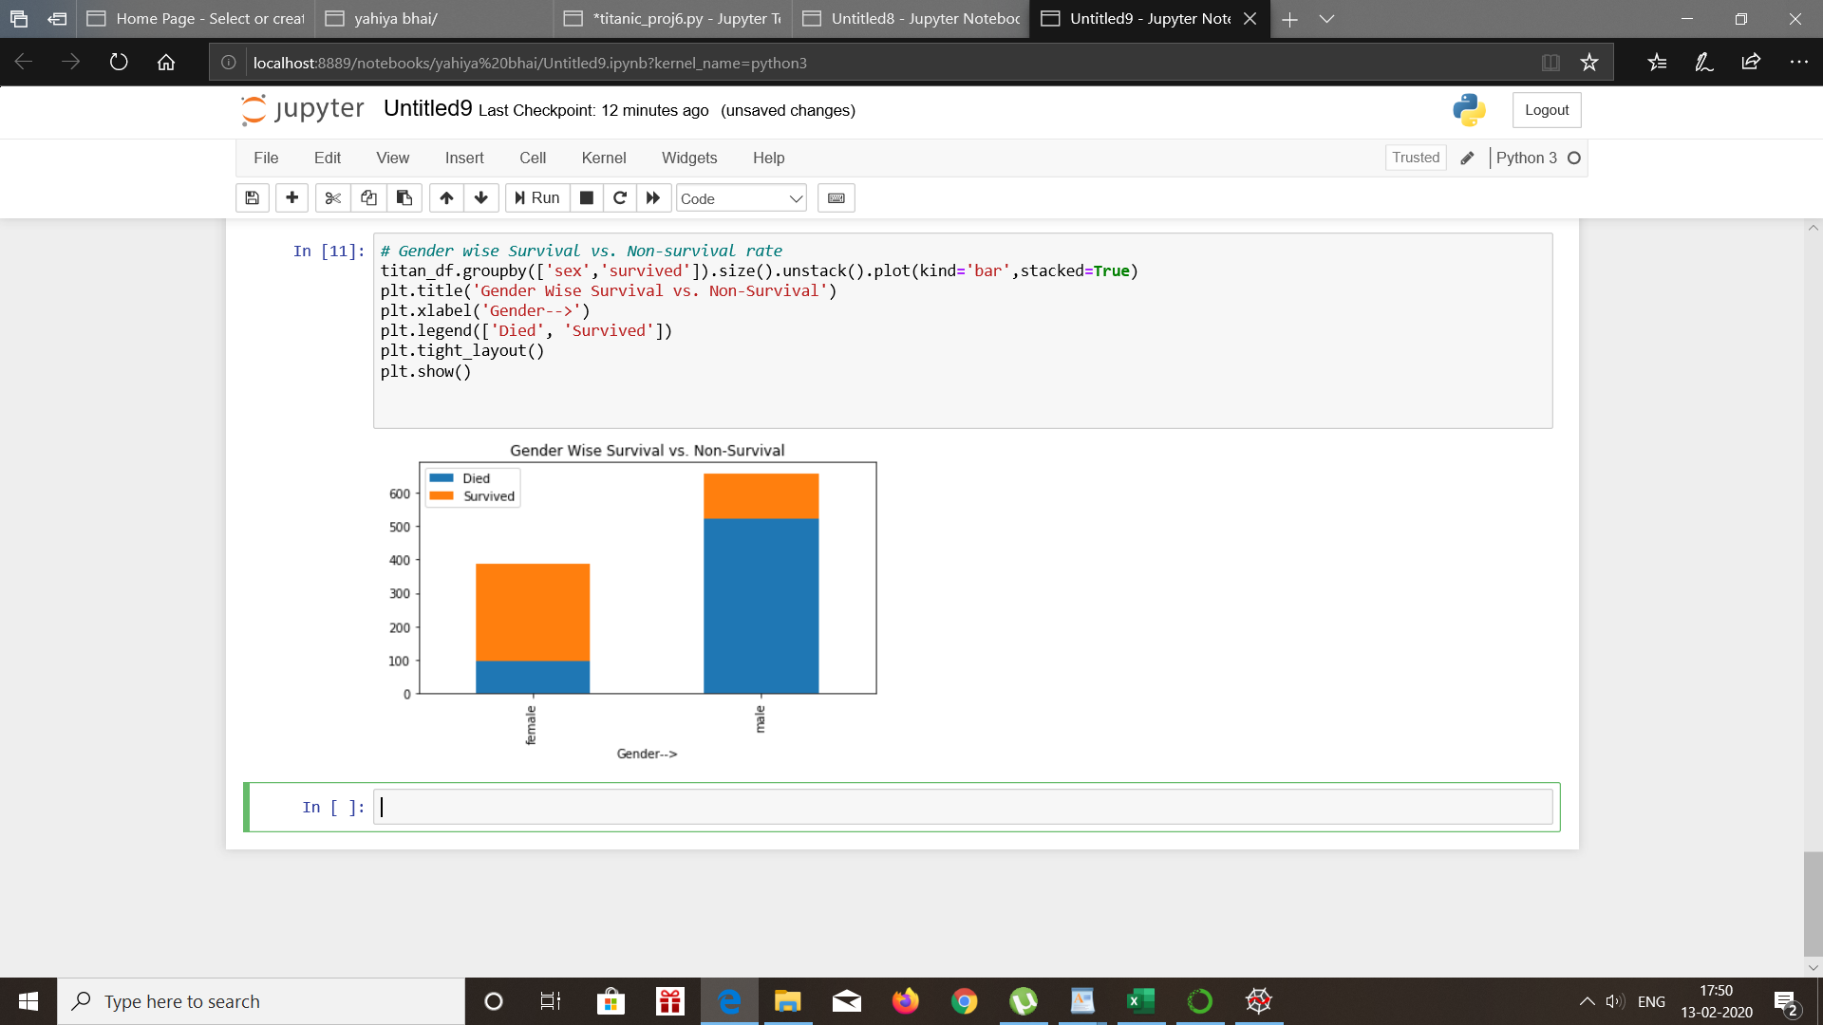
Gender Wise survival vs non survival

Slide 10
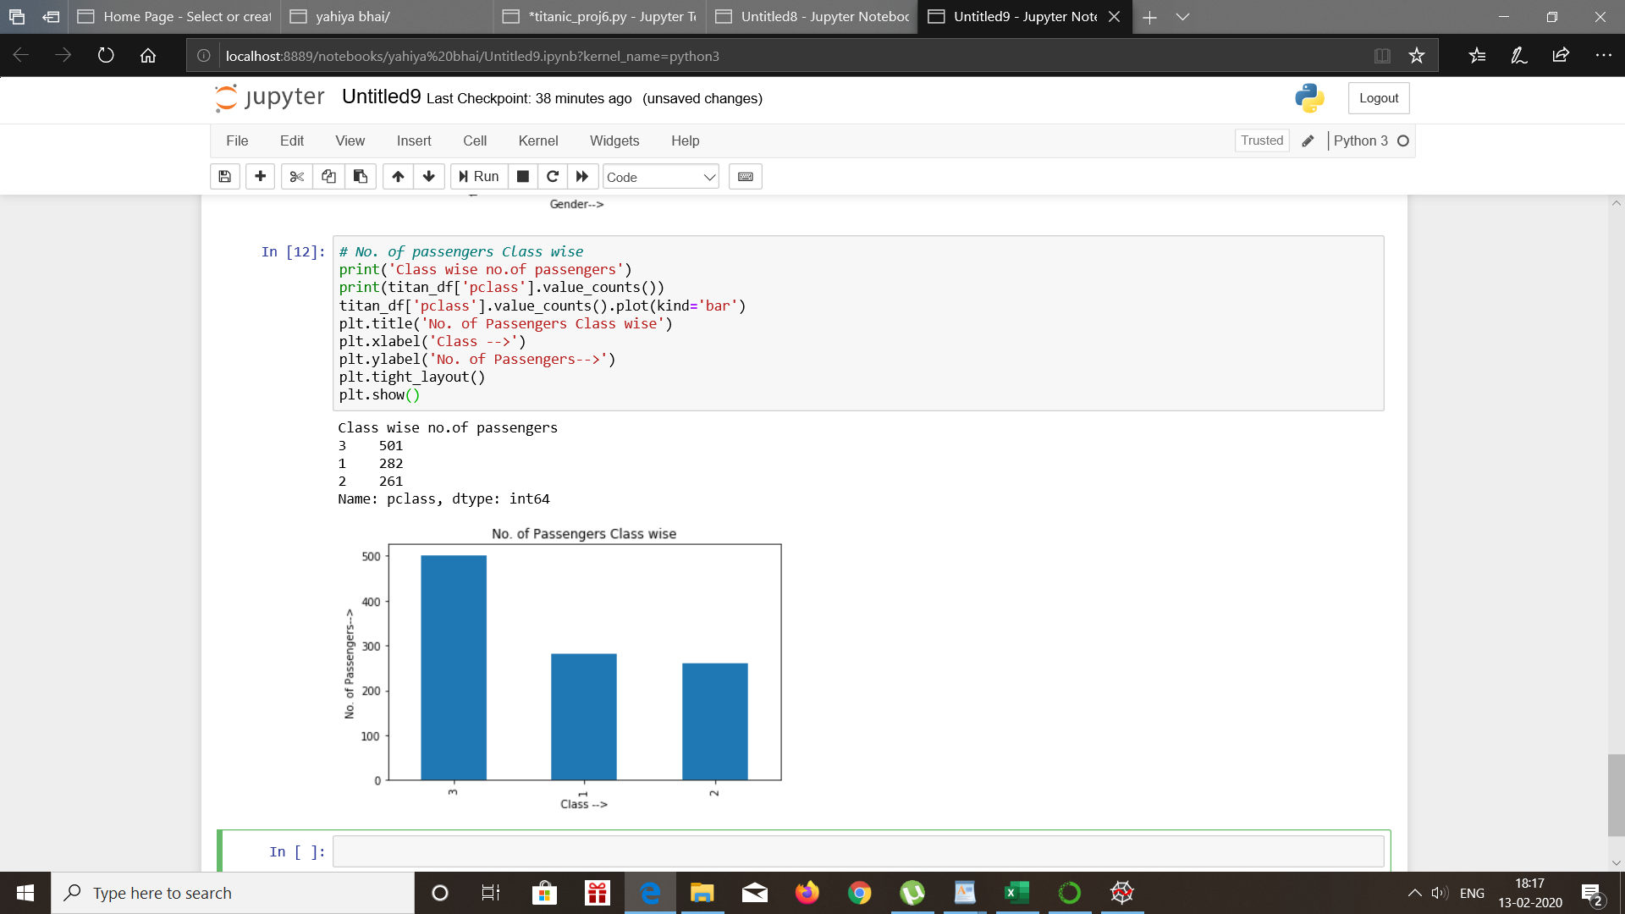
Class wise passengers

Slide 11
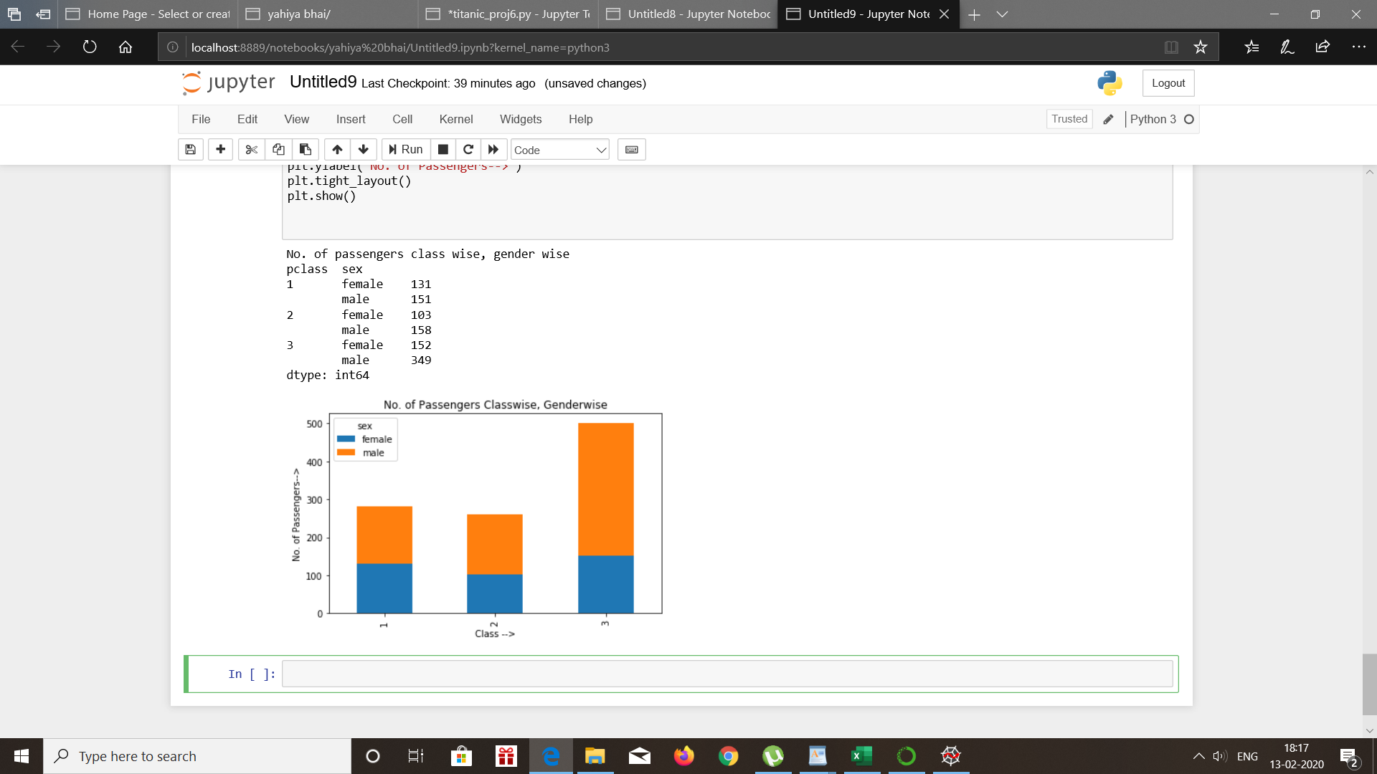
Passengers class wise ,gender wise

Slide 12
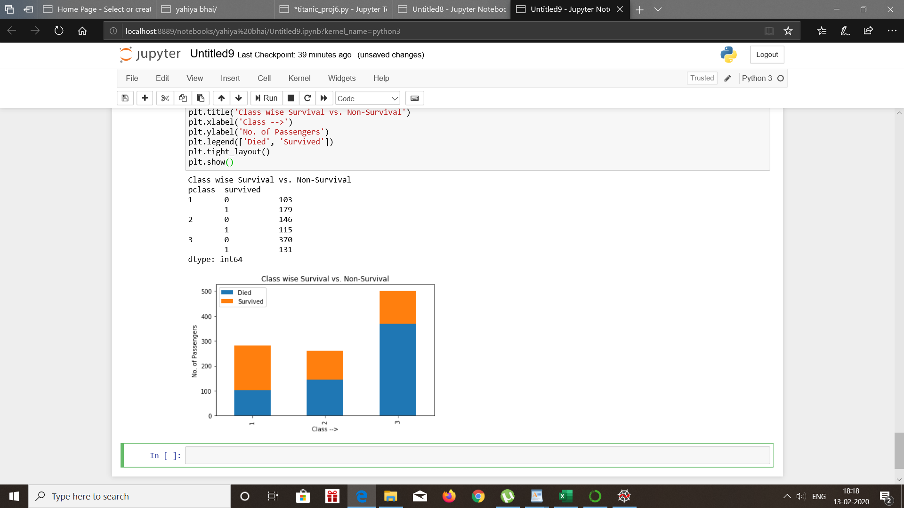
Classwise survival vs non survival

Slide 13
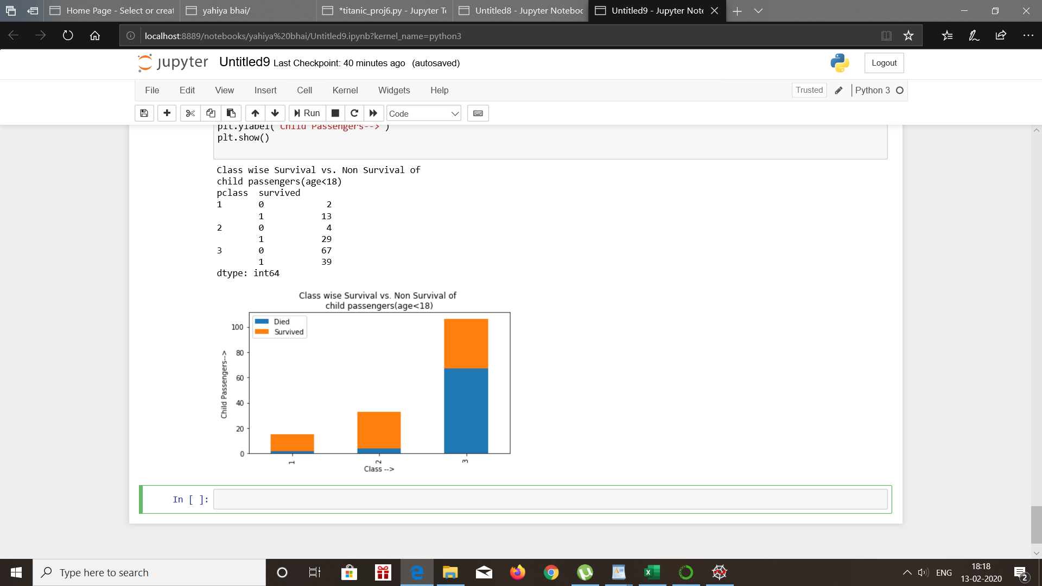
Class wise survival vs non survival of child

Slide 14
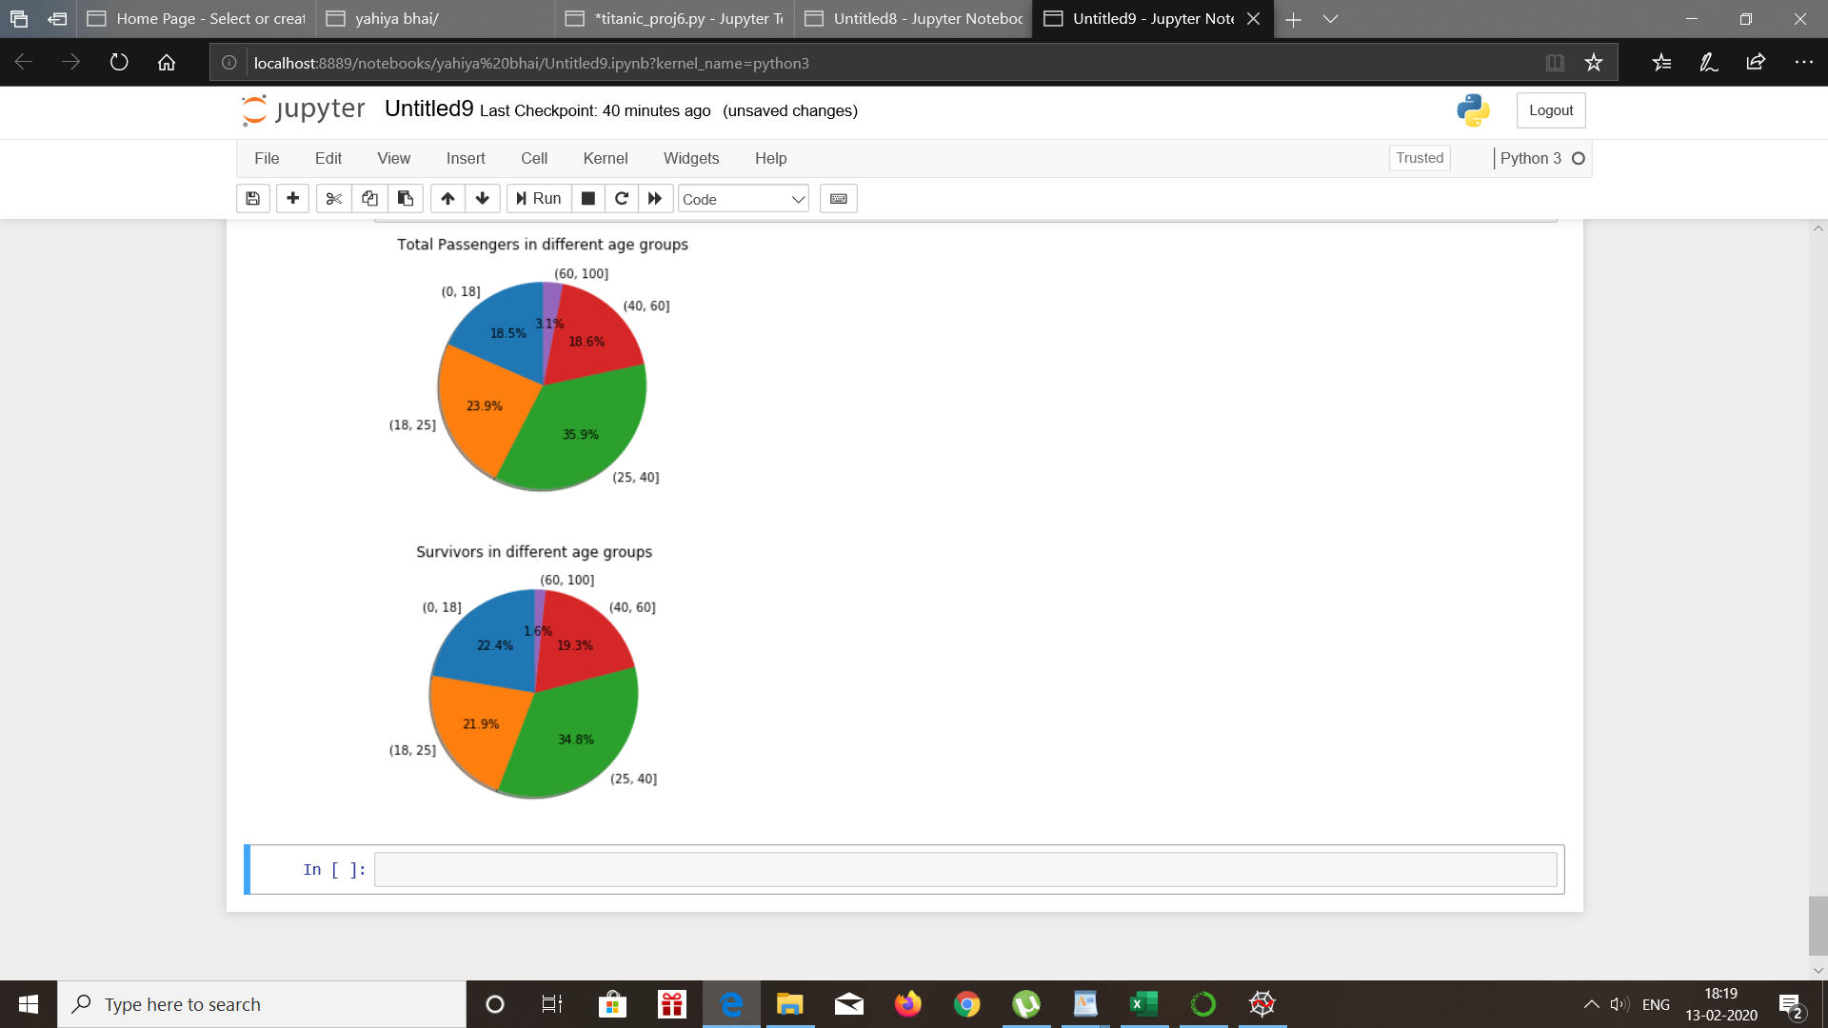
Total PASSengers and survivors in different age group

Slide 15
CONCLUSION
Machine learning is an application of artificial intelligence (AI) that provides systems the ability to automatically learn and improve from experience without being explicitly programmed. The process of learning begins with observations or data, such as examples, direct experience, or instruction, in order to look for patterns in data and make better decisions in the future, based on the examples that we provide. The primary aim is to allow the computers learn automatically without human intervention or assistance and adjust actions accordingly.
Our aim by " titanic survival prediction" is to try to analyze the number of survivals of different gender and different classes and different age group.

